Slide 1

VBA Stomping Advanced Malicious Document Techniques

Slide 2
Introductions
Harold Ogden @haroldogden
Systems Engineer Turned Blue Team
Security Operations & Continuous Monitoring Specialist
Dynamic Defense Engineer (Blue Team) for Walmart
Carrie Roberts @OrOneEqualsOne
Developer Turned Red Team
Senior Red Team Engineer for Walmart
Master’s in Information Security Engineering from the SANS Technology Institute, 2015
Kirk Sayre @bigmacjpg
Academic Cyber Security Tool Researcher Turned Blue Team
Dynamic Defense Engineer (Blue Team) for Walmart
PhD in Computer Science from University of Tennessee

Slide 3

Overview
VBA Stomping for Anti-detection and Anti-analysis
Real World Implications for Blue and Red
Malicious Document Crafting Fundamentals

Slide 4
File Format
Office 97
Proprietary file format
File is not compressed, but segments of file are compressed/compiled
Office 2007+ XML
Whole file is compressed
Open(ish) standard, parts are subfiles that are easily extracted
Format | Macros! | Zipped
97 | Yes | No
2007+ | No | Yes
2007+ Macro Enabled | Yes | Yes

Slide 5
Extensions Can Lie
XLS
Default extension for 97
Also will open 2007+ AND 2007+ Macro Enabled (compatibility!)
XLSX
Default extension for 2007+ macro-less
Must not contain macros
XLSM
Default extension for 2007+ w/ macros
May (will) contain macros
Format | Macros!
97 | Yes
2007+ | No
2007+ Macro Enabled | Yes
Format | Macros! | Zipped
97 | Yes | No
2007+ | No | Yes
2007+ Macro Enabled | Yes | Yes

Slide 6
Ambiguity Wins
XLS
Can be the zipped 2007+ format, may or may not have macros!
XLSX
Can not contain macros. Good for exploits, bad for macros!
XLSM
Obviously contains macros. Bad!
Format | Macros! | Zipped | Ext.
97 | Yes | No | .xls
2007+ | No | Yes | .xlsx / .xls
2007+ Macro Enabled | Yes | Yes | .xlsm / .xls

Slide 7
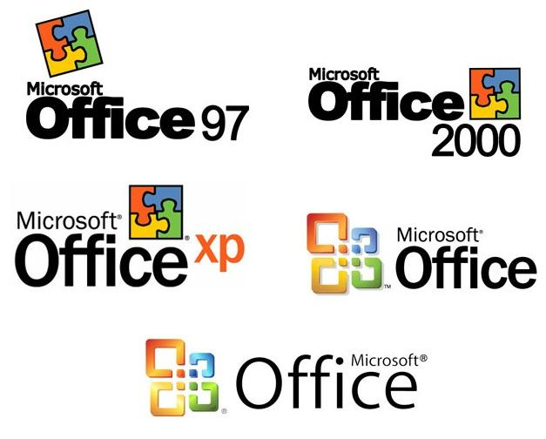
OLE! Object Linking and Embedding
Office 97
Whole document is an OLE compound file
VBA will be present in OLE storage as a sub-part of the file
Office 2007+
VBA is in OLE compound file(s), clearly separate from other document contents
Default is vbaProject.bin

Slide 8
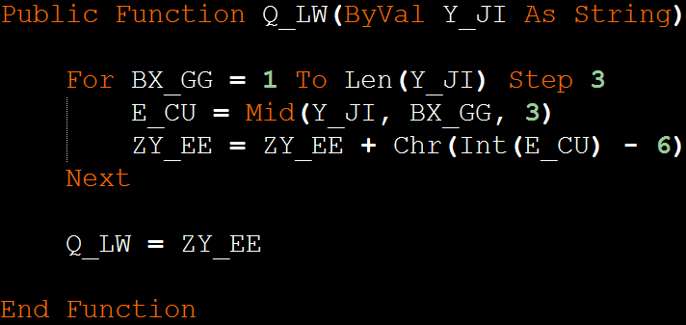
VBA – Crafting for Evasion

Slide 9
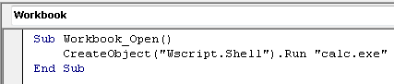
Create a Process
Shell$
Shell
CreateObject("Wscript.Shell").Run
WMI

Slide 10
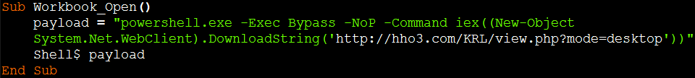
The Simplest of Payloads

Slide 11
Signature Fodder

Slide 12
Signatures and Sandboxes!
Store payload in a way that can be arbitrarily transformed
Use variable, function, and sub names that are too common to signature on their own
Test for fakenet and sandbox to avoid offline analysis
Obfuscation
Generalization
Anti-Analysis

Slide 13
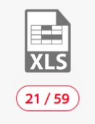
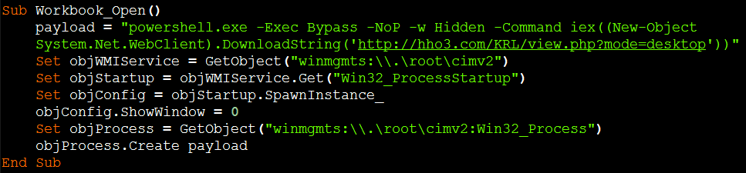
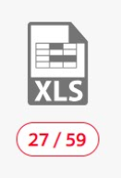
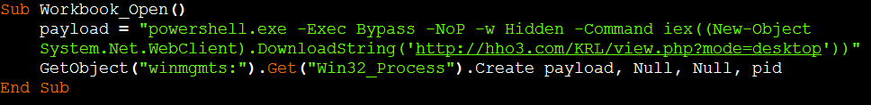
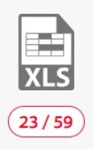
Ditch Shell$
5cb93bc5322b9b0a8fc5436fbc9a8ff1314018b1e68f3b75386bda28f96acd58
Ec4159c93ece699a4e381505321880cd329492cd1792ed8aaeeb6d23bfbe5daa
e3987c7a322c52ba095bdad9feced318e9098b380717df8595cc046034c3922b

Slide 14
Ditch Shell$
5cb93bc5322b9b0a8fc5436fbc9a8ff1314018b1e68f3b75386bda28f96acd58
Ec4159c93ece699a4e381505321880cd329492cd1792ed8aaeeb6d23bfbe5daa
e3987c7a322c52ba095bdad9feced318e9098b380717df8595cc046034c3922b

Slide 15
Detection rate went up! Why go with WMI?
Shell$ cannot be obfuscated. VBA has no “eval”
WMI is “bad”, but GetObject is ambiguous

Slide 16
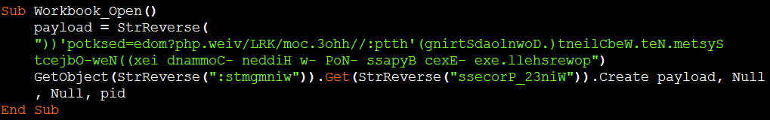
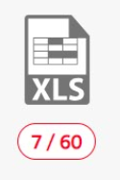
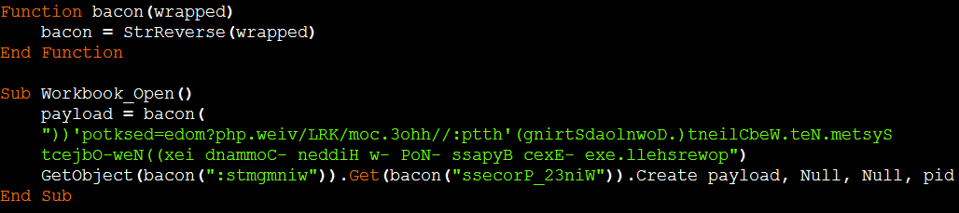
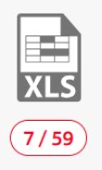
Flip it and reverse it
e9d02b2ed484cd1c944dc553a342e3166ce080205beb19d8132352beede8524c
534abc18618d90ef7936236ad0aeb3419a1e342374b7a2765830232cf38cf30b

Slide 17
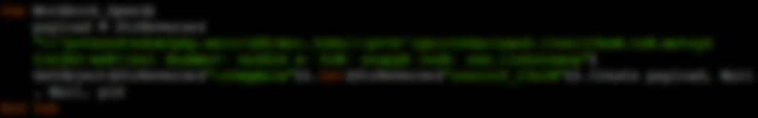
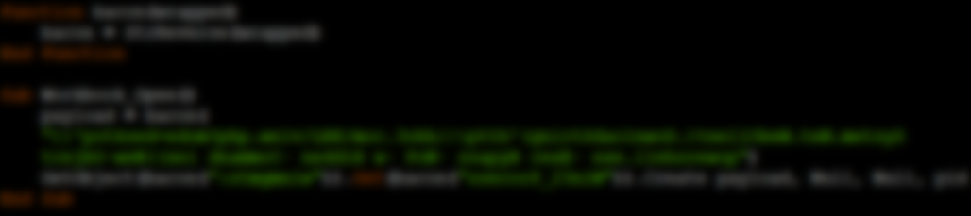
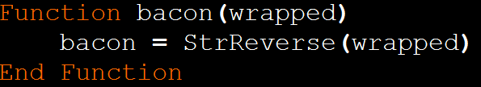
Flip it and reverse it
e9d02b2ed484cd1c944dc553a342e3166ce080205beb19d8132352beede8524c
534abc18618d90ef7936236ad0aeb3419a1e342374b7a2765830232cf38cf30b

Slide 18
Suspicious Methods and Strings
Methods can’t all be avoided – use only once
Obfuscate all strings in a data format that’s hard to signature
Use variable and function names that are hard to signature

Slide 19
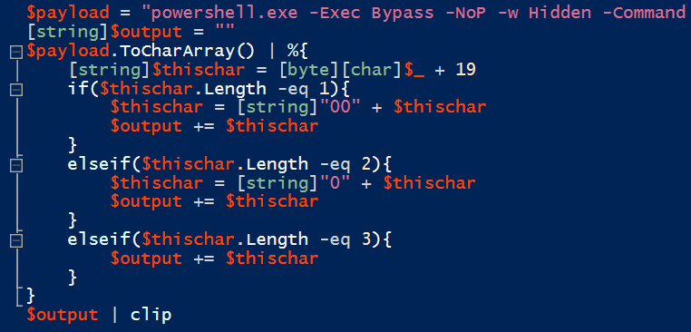
ROT19 is super secure

Slide 20
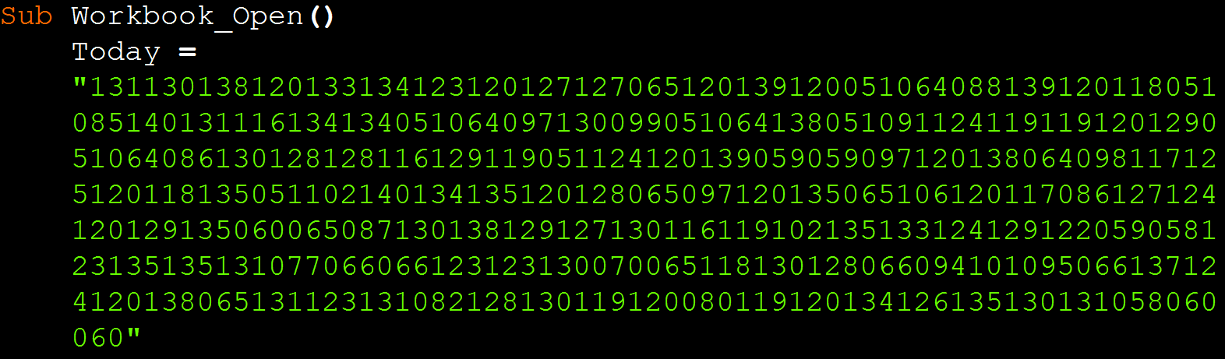
ROT19 is Super Secure

Slide 21
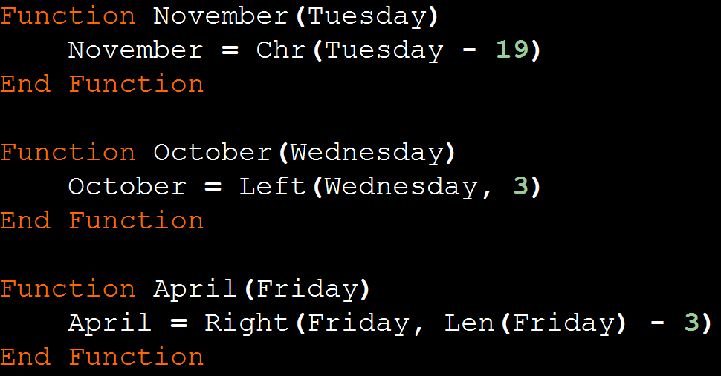
False Positive Time

Slide 22
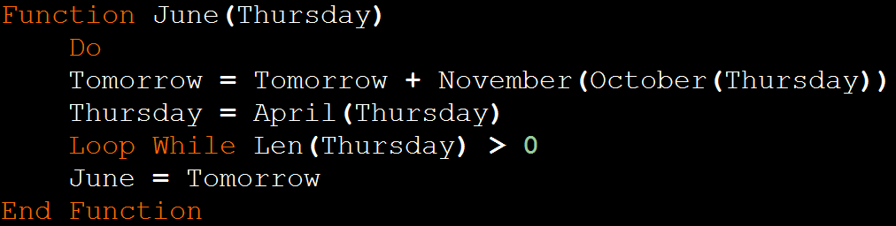
False Positive Time

Slide 23
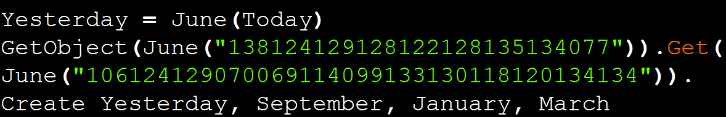
False Positive Time

Slide 24
False Positive Time
Uninitialized (Null)

Slide 25
False Positive Time
Winmgmts:
Win32_Process

Slide 26
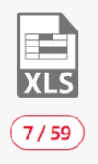
Holding Strong at 7
Same Detection Rate, but with robust obfuscation
Support for larger payloads
7d9236ca688f3c6a40725074e3ed4325d67353d24d2b74abe296204961e16aaf

Slide 27
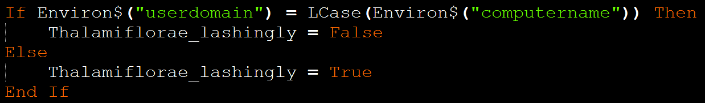
Anti-Sandbox
Unlimited options, pick those that are harder to fake in a VM
Take inspiration from the huge corpus of work already available, but write it yourself so it won’t have been patterned by AV
https://github.com/joesecurity/pafishmacro

Slide 28
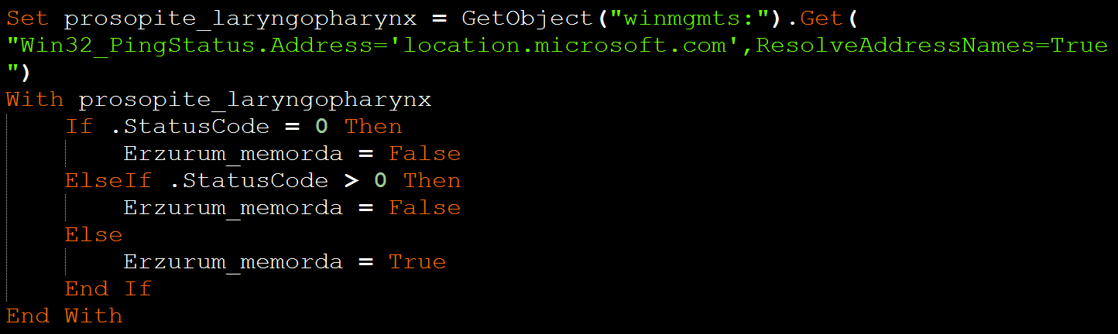
Anti-FAKENET
INetSim or similar are frequently used
Default behavior delivers a small Windows PE

Slide 29
Anti-FAKENET
Choose a fake but believable domain
If it resolves, or if it responds, don’t detonate

Slide 30
Anti-FAKENET – why WMI again?
Both strings can be obfuscated
Network traffic is not associated to Office process

Slide 31
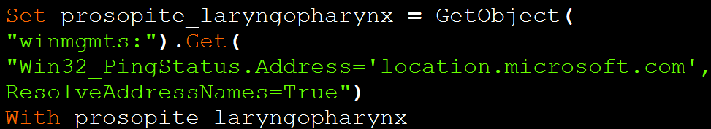
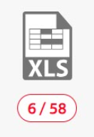
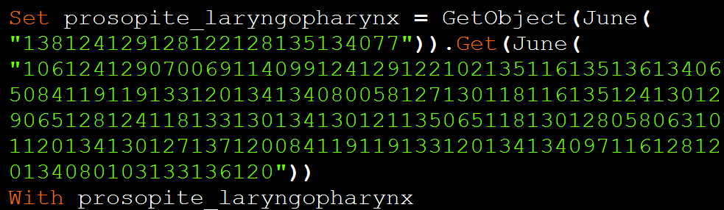
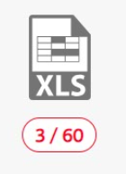
Anti-VM + Anti Fakenet = Anti-AV?
935a6fce94b1d9d8aa3078f088b110f3409c3c5865c915ab56f895ca40e3ebca
0cc2dd93f45d6d58c64329a4644bf18cb52abfa1e5da05f96f90aaefb96152bc

Slide 32
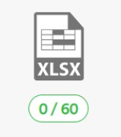
3 is good, but how about 0?
Security Products look at the compressed VBA source
What if we didn’t need that source?
Stomp the VBA source, macros still run!*
94adb7ed5671ce32608b600826b06ccfd13cb817972734a77d851ff82ca1ed0c

Slide 33
Macro Storage (VBA) within Office Documents
VBA stored as:
Source Code - the original code as entered by the programmer (compressed)
P-code - a compiled Pseudo-code
Execodes
Dr. Vesselin Bontchev https://github.com/bontchev/pcodedmp
← This is what executes most of the time

Slide 34
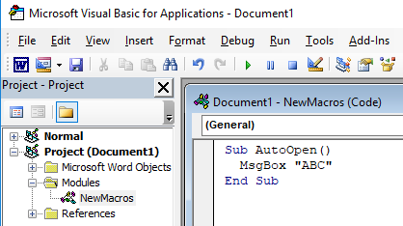
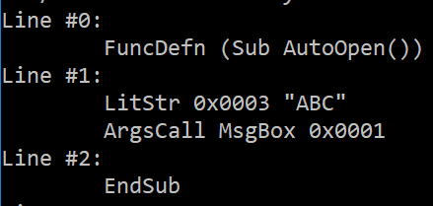
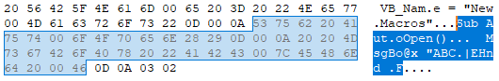
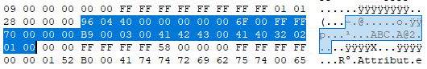
Source Code
P-Code
Compressed and Stored in vbaProject.bin
Notes:
FuncDefn 150=x96
LitStr 185=xB9
ArgsCall 65= x41
EndSub 111=x6f

Slide 35
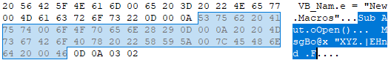
Modifying Compressed Source Code in vbaProject.bin

Slide 36
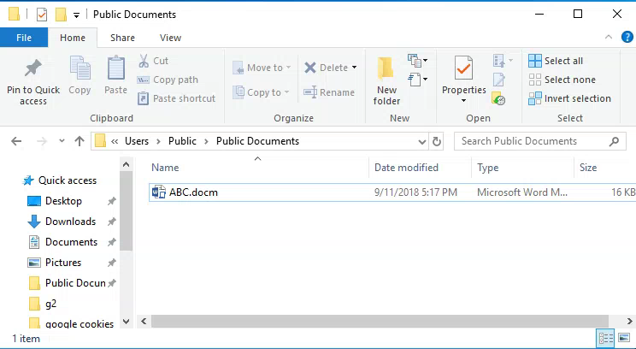

Slide 37
WYSIWYG? What You See Is (not necessarily) What You Get
What is Displayed in the VBA Editor:
Before Macro’s Enabled | After Macro’s Enabled
Decompressed VBA Source Code | Decompiled P-Code
What Gets Executed:
Compatible P-code? | Incompatible P-code
P-code | VBA Source Code compiled to P-code

Slide 38

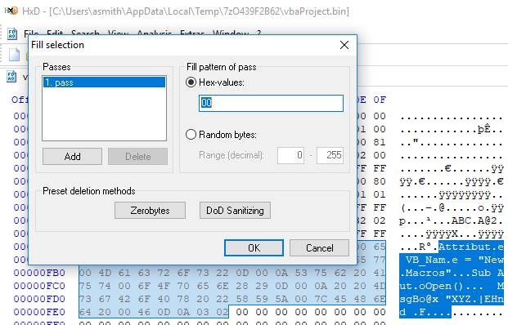
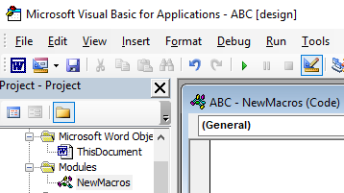
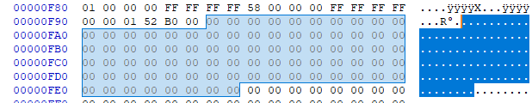
VBA Stomping
Completely wipe-out compressed VBA source
BEFORE
AFTER

Slide 39
WYSI(not)WYG
A careful user will be tricked
Most AV scanners look only at the VBA source code
Dr. Vesselin Bontchev https://github.com/bontchev/pcodedmp

Slide 40
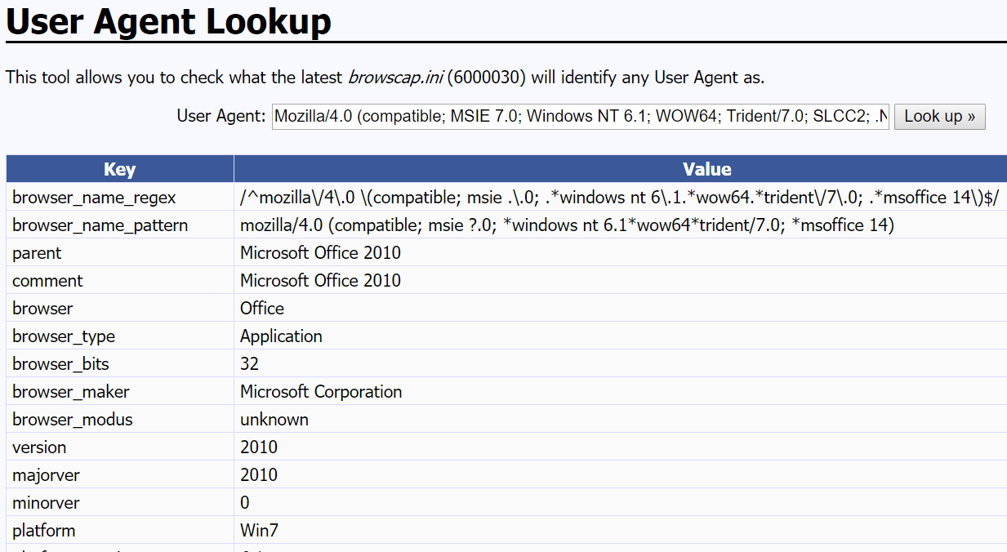
P-Code Compatibility
Notes:
If running a targeted attack:
Perform recon to determine the proper Office and Windows OS version to use to create the stomped maldoc.
If serving maldocs from a web server:
Generate stomped maldocs for all OS/Office versions of interest.
Fingerprint the user agent the target uses to connect to the web server to make an educated guess as to which maldoc version to serve out.
If delivering maldocs via a spam email campaign:
Spray out multiple versions of the stomped maldoc.

Slide 41
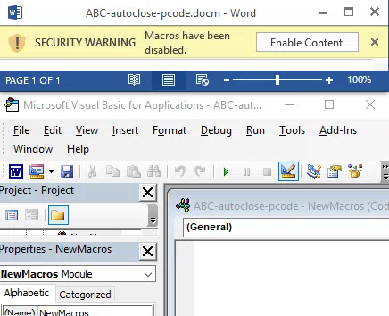
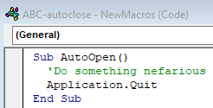
Anti-Analysis

Slide 42
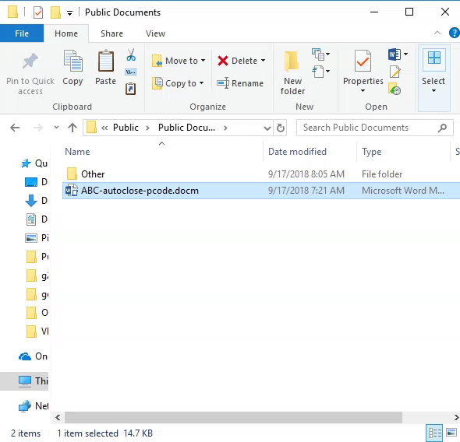
Disable Auto Execution of Macros
Delete word/vbaData.xml
Works For All Auto-Run Techniques
https://www.blackhillsinfosec.com/phishing-with-powerpoint/

Slide 43
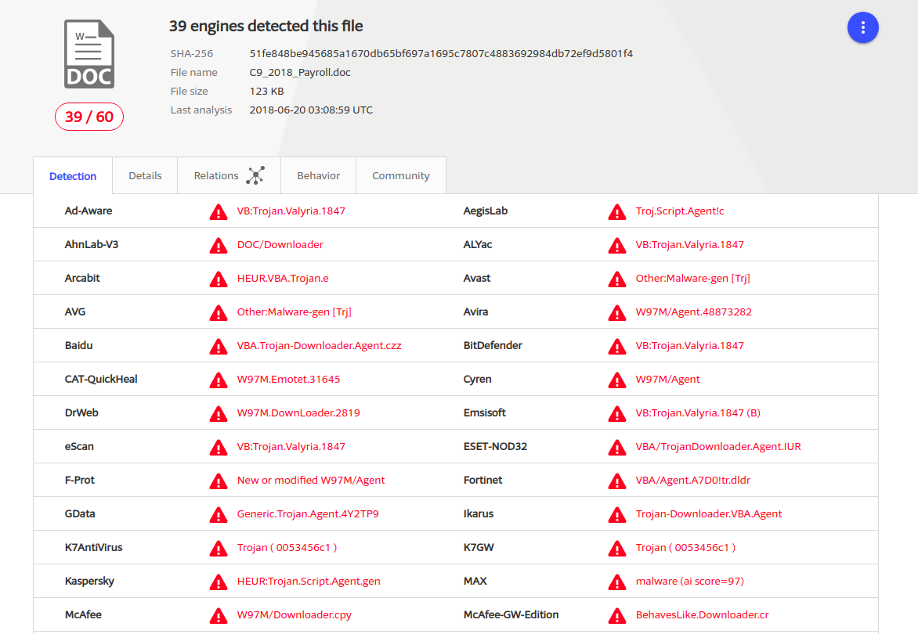
Real World VBA Stomping Example
June 2018 Emotet Malicious Document
39 of 60 Detections
MD5: a81f7899f38328e8ee8a9c7de0839954

Slide 44
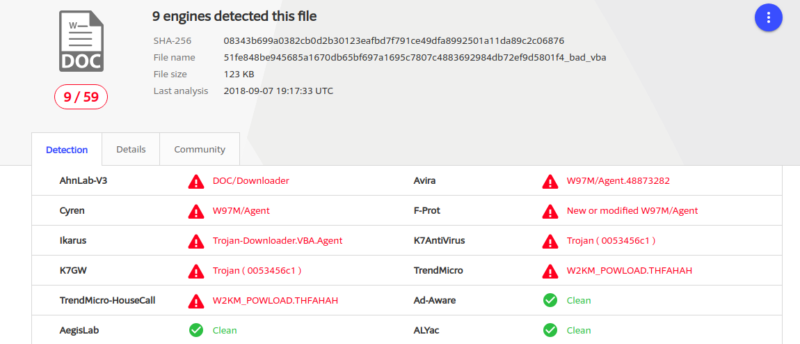
Real World VBA Stomping Example
VBA Stomped Emotet Document
30 fewer detections
Woot!
MD5: e145f811229479bcede5bfdc8b56d82e

Slide 45
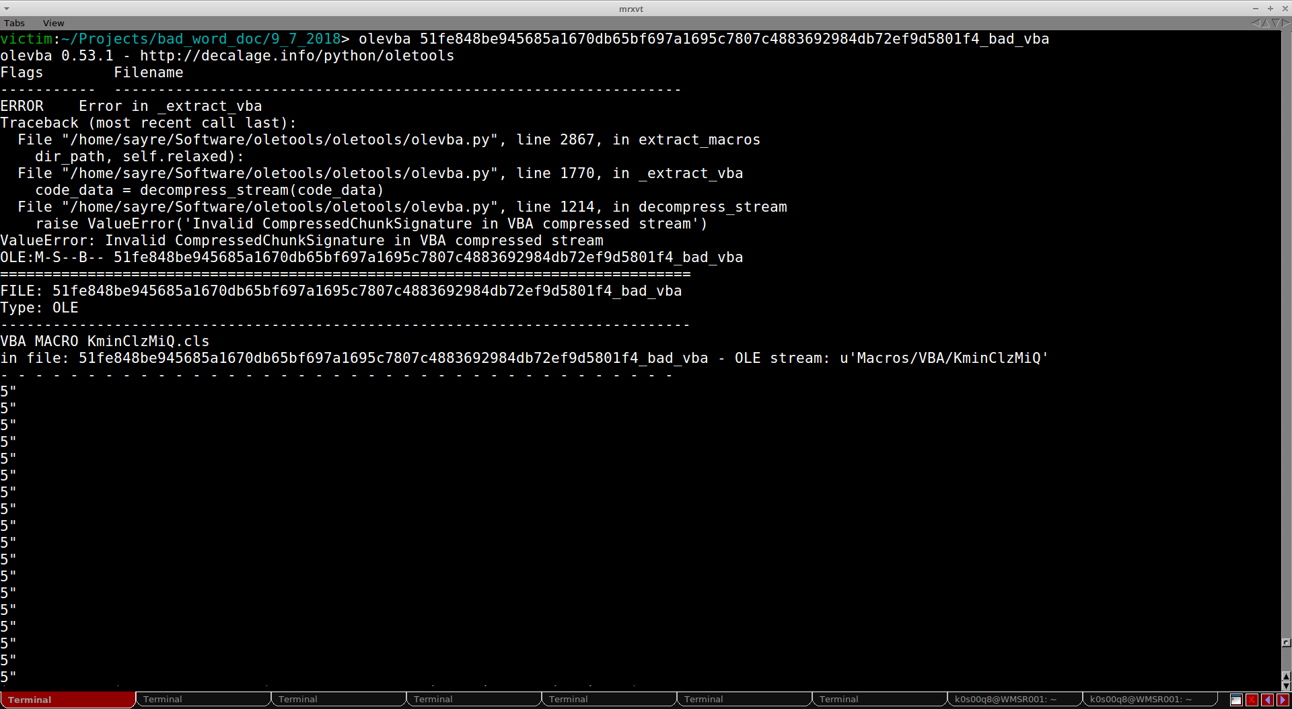
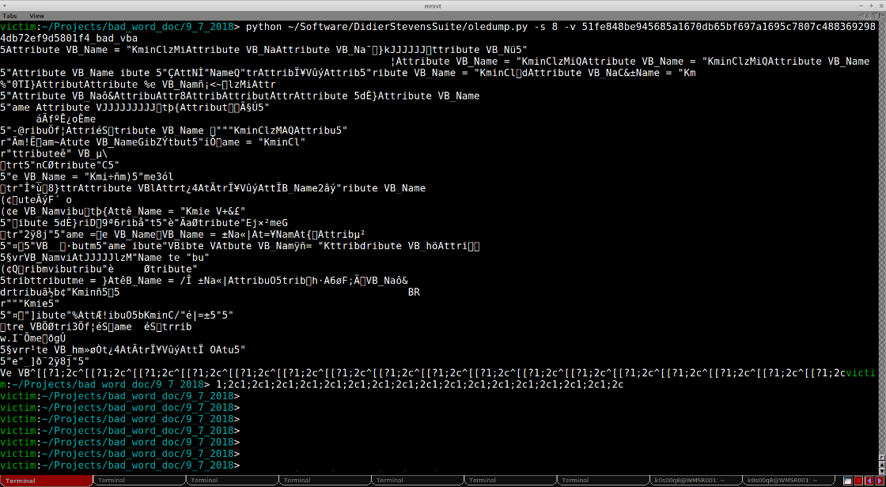
VBA Stomping Analysis Problems
olevba (https://www.decalage.info/python/olevba)
oledump (https://blog.didierstevens.com/programs/oledump-py/)
Error
Garbage

Slide 46
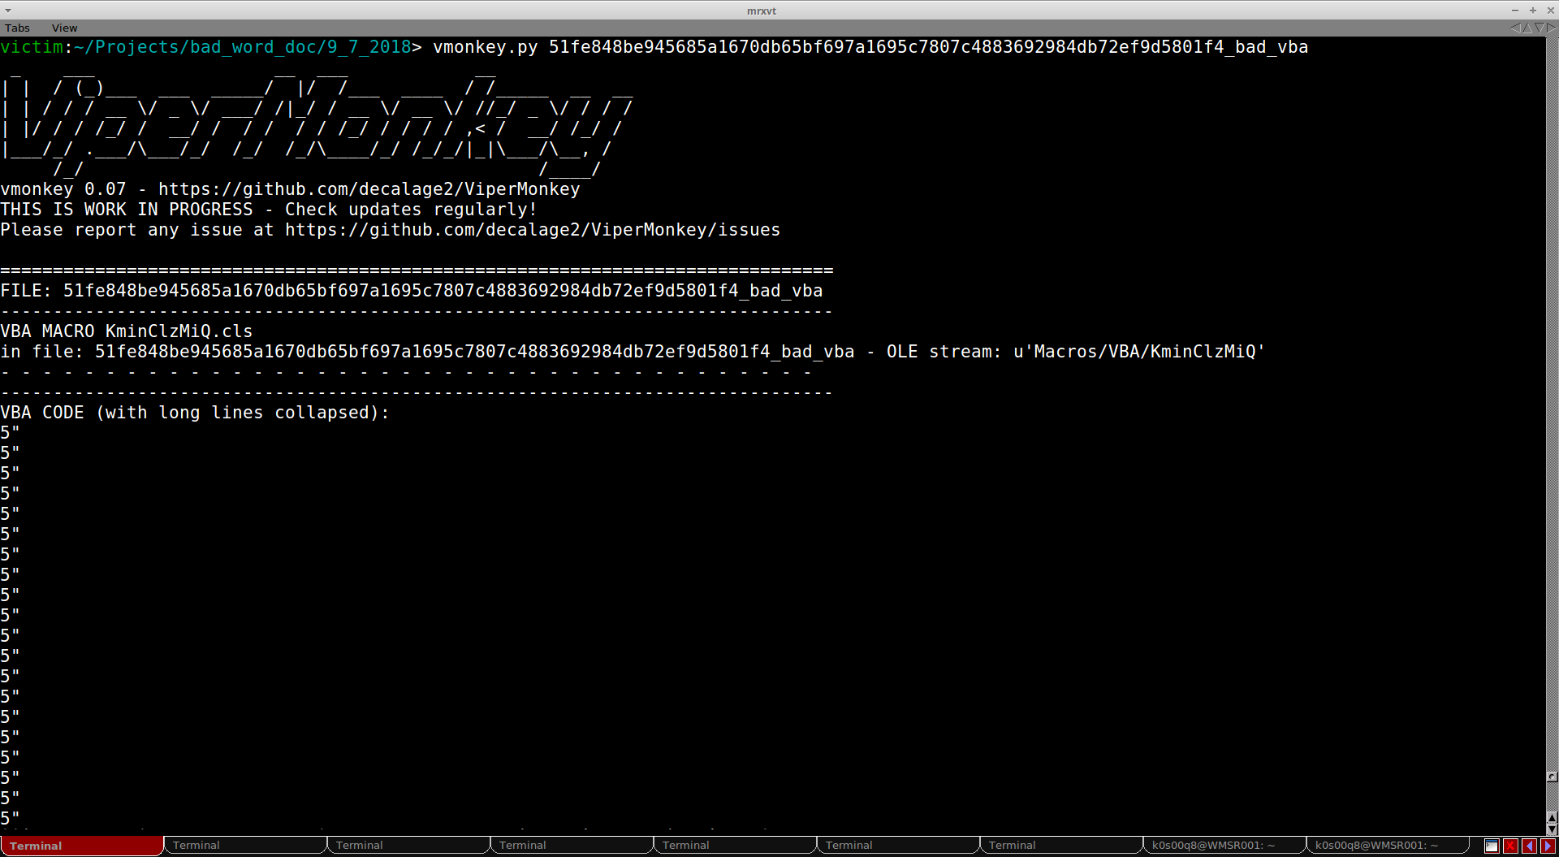
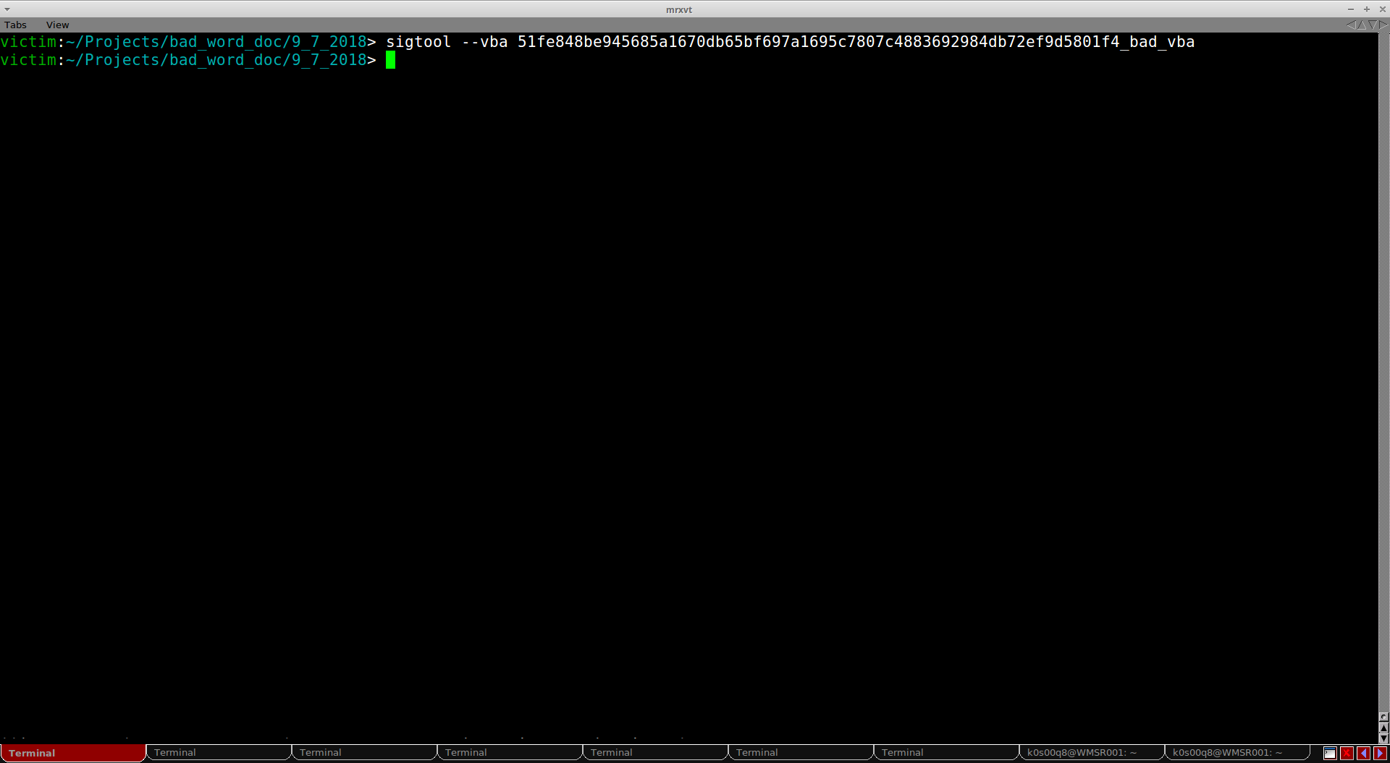
VBA Stomping Analysis Problems
ViperMonkey (https://github.com/decalage2/ViperMonkey)
ClamAV sigtool (http://www.clamav.net/)
Nothing
Garbage
Garbage

Slide 47
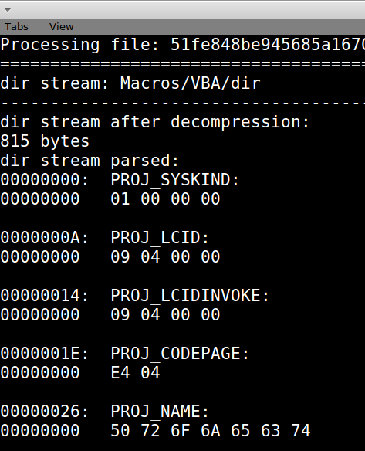
VBA Stomping Defense
P-Code unchanged by VBA Stomping
P-Code Disassembler (https://github.com/bontchev/pcodedmp)
Original
Stomped

Slide 48
VBA Stomping Defense
P-Code Based Signatures
Detect VBA <-> P-code mismatch
Sandbox Execution
With multiple Office/Windows versions

Slide 49
P-Code Based Signatures
rule pcode_too_many_Mid_calls
{
meta:
author = "Kirk Sayre - Walmart Information Security"
description = "Check for many Mid() calls looking at VB compiled to P-Code."
strings:
// Headers of files to look for
$header_office = { D0 CF 11 E0 }
$header_xml = "<?xml version=" nocase wide ascii
// Look for calls like Mid("xxxxxx", 2, 3) or Mid(foo, 2, 3).
//
// Disassembled P-Code:
//
// 00B6 LitStr 0x0065 "some static string..." (string literal)
// or
// 0020 Ld jzziiaRT (variable)
// 00AC LitDI2 0x000F
// 00AC LitDI2 0x004A
// 0024 ArgsLd Mid 0x0003
$mid_call = /((\xB6.{1,100})|(\x20..)).\xAC..\x00\xAC..\x00\x24\x00\xFA\x00\x03/
condition:
(($header_office at 0) or $header_xml) and
(#mid_call > 75)
}

Slide 50
Detect VBA <-> P-code Mismatch
We do not know of AV tools that do this.
VBASeismograph: We wrote our own open-source tool.
https://github.com/kirk-sayre-work/VBASeismograph
Written in Python.
MIT License.
Detects VBA source code <-> P-code mismatches.

Slide 51
Questions?
References, blog posts and slides available at:
https://vbastomp.com
?
?
Harold Ogden @haroldogden
?
Kirk Sayre @bigmacjpg
?
?
Carrie Roberts @OrOneEqualsOne

